Slide 1
CS4730: Computer Game Design
Course Introduction

Slide 2

Overview
Lecture:
MW 11:00-11:50 @ Olsson 120
Lab:
Th 12:30-1:45 (Rice 120) or 2-3:15 (Rice 340)
Mark Floryan, mfloryan@cs.virginia.edu
Rice 203
OH by appointment only.
I’ll mostly make myself available during class
Tas
Soon

Slide 3

Books
You need to purchase:
“Reality is Broken” by Jane McGonigal
There will be other readings through Collab
Please purchase this book asap!!

Slide 4
Course Outline
Lectures:
Two per week
About half on technical details of building game engine, games, etc.
About half on Game design, level and character design, pacing, tutorials, etc. in games.
Labs:
One per week
Mostly time for you to work on project / homework
Weekly check ins with Tas
One or two groups will present their work so far each week

Slide 5
Workload
Project:
Each group will have 9 students broken down into 3 teams of 3
Engine Team: Focuses on building out the engine and lower level things
SFX/Level Team: Focuses on using the engine to build the games features (e.g., interactions between weapons and enemies, gameplay mechanics, etc.) and some special effects (Camera, sound, etc.)
Design / Character Team: Designs the game and programs the main character, and the bosses.
Final Exam:
Really just a short multiple choice quiz (about 60 questions)
Ensures you came to class and cared about the content
Will have questions from the book

Slide 6
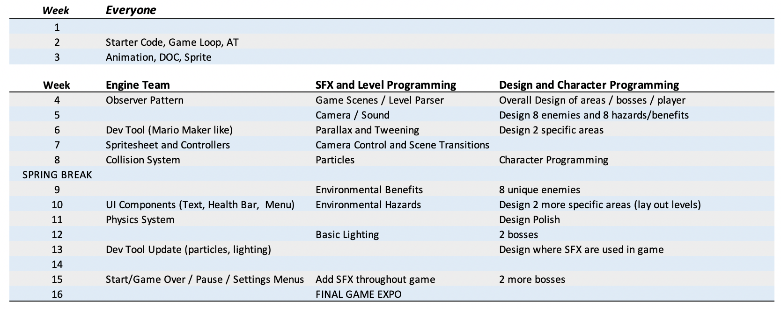
HW Schedule

Slide 7
Let’s Talk About Grading
All homework will be graded into one of the following categories:
Unsatisfactory: The work does not meet an appropriate standard for credit
Competency: The work is passable, but not quite up to the high standard we expect.
Satisfied: The work reaches the minimum standard we expect.
**Unsatisfactory homework can be resubmitted in person to me or a TA for a regrade at any time, but MUST be done in person.

Slide 8
Grading Policy

Slide 9
Lecture/Lab Attedance
Poison Status:
Every lecture I will randomly select 15 or so names for attendance checks and “shoot a poison arrow at you”.
If you are are not present, the “arrow hits” (how the heck does that work?).
Each hit poisons you. One of your assignment is demoted one grade level.
Just for you, not for your whole team.

Slide 10
More About the Project
Technologies:
We will be using SDL2 (https://www.libsdl.org/download-2.0.php)
SDL2 is a simple graphics wrapper for C++. Allows us to create windows, draw images and simple shapes to the screen, etc.
I will teach you:
The VERY basics of SDL2
Provide you with starter code that opens a window and draws one image.
Immediate Schedule:
Week 1: Get into groups and start pitching game ideas
Week 2: Get started working on assignments

Slide 11
More About the Project
Size of the game:
Because the groups are bigger, I expect you to produce larger, fully playable games by end of semester.
Your game is MUST have the following:
About 45 mins – 1.5 hours for a new player to finish
Have complete art assets and music throughout (though you get free online)
Contain a main character or entity
Include four explorable spaces / regions / areas / levels
Each area must have at least 8 rooms (each must be larger than one screen)
8 different “enemies” or similar
8 different environmental objects to interact with (Ice blocks, etc.)
4 ”bosses” (or boss like final challenges)
Some kind of loose narrative or purpose (why is the player doing all this?)

Slide 12
More About the Project
Why all the requirements?
Bigger projects are harder to manage. If all of the projects have roughly the same broad strokes, I can write better assignments and guide you better.
Lectures will focus on level design of the general genre of adventure, exploration, platforming type games (very broad, I know). So I want to avoid any groups just remaking Tetris.
Assignments (especially the design assignments) are heavily geared towards this kind of game anyway, and examples from class will be more relevant to your work with this structure.

Slide 13
Expected Challenges
This is an experiment, here are some challenges:
Organizing code across big groups with three teams will be challenging. I’ve tried to design assignments to separate the work as cleanly as possible but not always reasonable.
All games will be a bit different so later assignments will be a little bit vague (e.g., add some kind of particle effects to your game!)
C++ is a better choice for game development, but also harder to deal with. Need to write destructors and clean memory efficiently, work with pointers, etc.
Gathering art assets will be a challenge (especially animated ones for the character, bosses, etc.). We will need to think about how to efficiently acquire these for free. I may have some funds to buy some art assets, we will see.

Slide 14
Quick Discussion:
What is, in your opinion, the best designed game you’ve ever played and why?

Slide 15
My Top 10 Games (no order)
Super Metroid (SNES) *A masterpiece
Final Fantasy 6 (SNES) *Though many FFs are great
Mega Man 3 (NES) *When it peaked
Zelda *(Breath of the Wild (Switch), ALTTP (SNES), and Ocarina of Time (N64))
Super Mario 64 (N64) *Odyssey, SMB4 are great too
Dark Souls (PS3) *If you want to cry
Starcraft (PC) *Despite the clunky controls
The Last of Us (PS3) *
Goldeneye (N64) *Hard to explain why this one is good
Metal Gear Solid 3 (PS2) *is the best one for sure

Slide 16
Some other games I love
Super Meat Boy (PC)
Hollow Knight (PC) *copied from super Metroid, but still great
Mario Kart (Many) *though getting old at this point
Super Smash Bros (N64) *not obsessed, prefer original version
Grand Theft Auto (PS2/3) *3 and 5
Celeste (PC) *Seriously, go play this one
Chrono Trigger (SNES) *Classic no one has heard of
Super Mario RPG (SNES) *Not sure why this is so great
…and many more

Slide 17
Ok, who cares?
As we study the design of games, we will do so using many examples of real games. An example:
Games teach players
their mechanics:

